Slide 1

Bike Sharing Data Analysis & Executive Dashboard
NextHikes Project –1
Presented by – Bhavdeep Kaur

Slide 2
Project Overview
Problem Statement
Urban bike-sharing systems generate large volumes of rental data every day. This project analyzes rental patterns, customer behavior, and environmental factors to help improve operational efficiency and support data-driven business decisions.
Project Objectives
• Analyse bike rental demand patterns
• Compare casual and registered customer behaviour
• Evaluate weather and seasonal impact
• Identify peak operational hours and weekday trends
• Build interactive dashboards for business insights
🚲 Bike Sharing
📊 Data Analysis
📈 Business Insights
Project Outcome
Deliver two interactive dashboards that transform raw rental data into actionable business insights for operational planning and strategic decision-making.
📋Executive Dashboard

Slide 3

Dataset Overview
📂 Data Source
The dataset was provided as part of the NextHikes Project 1 and contains historical bike-sharing rental records along with customer and environmental information.
📊 Dataset Statistics
Total Records: 1,000
Features: 16
Datasets Analyzed: 3
Business Dashboards: 2
🗂 Dataset Structure
The dataset includes:
Date & Time Information
Customer Information
Weather Conditions
Environmental Factors
Rental Counts

Slide 4
Tools & Technologies
📗Microsoft Excel
Primary platform used for data cleaning, analysis, and dashboard creation.
🔍 XLOOKUP
Merged datasets and retrieved related information efficiently.
📊 Pivot Tables
Summarized large datasets into meaningful business insights.
📉 Data Visualization
Presented insights using charts, KPIs, and business visuals.
🎨 Conditional Formatting
Created heat maps and highlighted important patterns.
📋 Dashboard Design
Built interactive dashboards for executive reporting.
📈 Pivot Charts
Visualized rental trends and customer behavior.
💡 Business Analytics
Converted raw data into actionable recommendations.
Why These Tools?
These technologies enabled efficient data preparation, analysis, visualization, and dashboard development, transforming raw bike-sharing data into actionable business insights.

Slide 5
Quote
Data Cleaning & Preparation
📂 Raw Dataset
Bike-sharing rental records
Customer information
Weather & seasonal data
Date and time details
📈 Analysis Ready
Built analytical reports
Designed interactive dashboards
Extracted business insights
Developed executive summary
🧹 Data Cleaning
Verified dataset consistency
Standardized data format
Organized data for analysis
Prepared records for processing
🔄 Data Preparation
Created Pivot Tables
Used XLOOKUP for merging
Added helper columns
Prepared Dataset A & Dataset B
Outcome
The prepared data enabled accurate analysis, interactive dashboard development, and data-driven business recommendations.

Slide 6
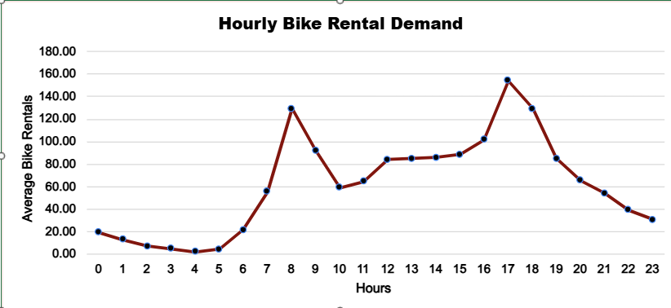
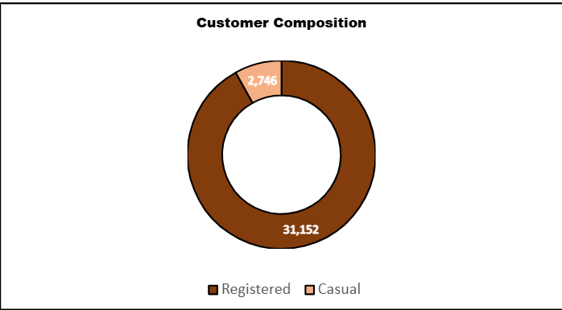
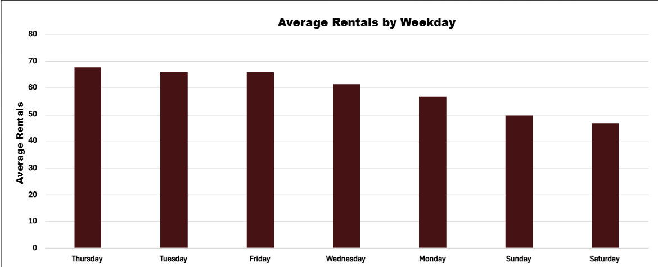
Key Analysis & Insights
Key Findings
Bike rentals peaked during 8 AM and 5 PM, reflecting daily commuting patterns.
Registered users accounted for over 91% of total rentals.
Friday recorded the highest average bike rentals

Slide 7
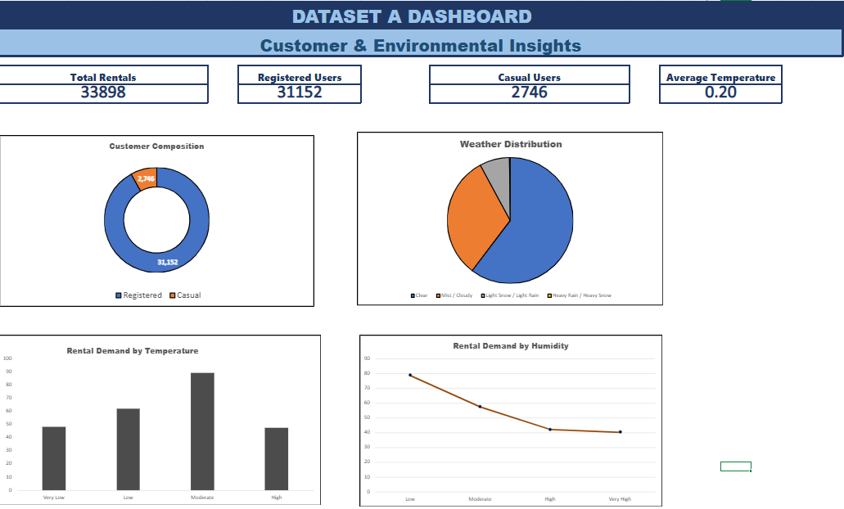
Dataset A Dashboard
📊 Dashboard Highlights
Purpose
Provides a consolidated view of customer behavior and environmental factors affecting bike-sharing demand.
Key Components
📈 KPI Cards
👥 Customer Composition
🌤 Weather Distribution
🌡 Temperature Analysis
💧 Humidity Analysis
🎯 Key Takeaways
Registered users contributed 91.9% of total rentals.
Clear weather generated the highest rental activity.
Moderate temperatures resulted in the greatest rental demand.
Higher humidity was associated with lower rental activity.

Slide 8
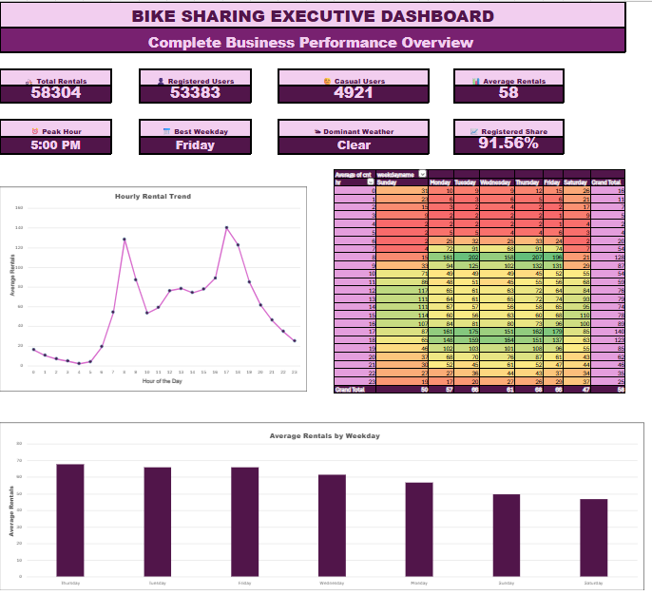
Executive Dashboard
📊 Dashboard Purpose
Provides an executive-level overview of bike-sharing performance by combining operational trends, customer insights, and key business metrics into a single dashboard.
📌 Key Features
📊 8 KPI Cards
📈 Hourly Rental Trend
🔥 Demand Heat Map
📅 Weekday Performance
📄 Executive Summary
💡 Strategic Recommendations
🎯 Business Impact
Enabled faster interpretation of business performance through interactive KPIs.
Identified peak rental periods for improved fleet planning.
Supported operational decisions using demand and customer insights.
Presented actionable recommendations for business optimization.

Slide 9
Project Outcomes
📊 Major Findings
✔ Registered users accounted for 91.56% of total rentals, indicating a strong commuter-based customer base.
✔ Bike rentals peaked during 8:00 AM and 5:00 PM, reflecting daily commuting patterns.
✔ Friday recorded the highest average rental demand among all weekdays.
✔ Clear weather generated the highest rental activity, while higher humidity reduced demand.
✔ The dashboards successfully transformed raw rental data into actionable business insights.
Skills Demonstrated
📂 Data Cleaning & Preparation
📊 Exploratory Data Analysis (EDA)
📈 Pivot Tables & Pivot Charts
🔍 Data Integration using XLOOKUP
📋 Dashboard Design
📉 Data Visualization
💡 Business Analytics
📑 Executive Reporting
🌟 Project Achievement
Successfully developed an end-to-end Excel analytics solution, transforming raw bike-sharing data into interactive dashboards that support data-driven business decisions.

Slide 10
Conclusion
Project Summary
This project successfully transformed raw bike-sharing rental data into meaningful business insights through structured data analysis, interactive dashboards, and executive reporting. The findings demonstrated how customer behavior, operational demand, and environmental factors influence bike-sharing performance and support data-driven decision-making.
Future Scope
Develop interactive dashboards using Power BI.
Automate data preparation with Power Query.
Apply predictive analytics to forecast future rental demand.
Integrate real-time weather and operational data.
Thank You!
Bhavdeep Kaur
NextHikes Project
Bike Sharing Data Analysis & Executive Dashboard

